Slide 1

Game Theory Six
From
Mathematical Optimization and Economic Theory
Jacob Wyngaard

Slide 2

Lemke-Howson Algorithm with $3×3$ payoff matrices
Player 1 Payoff Matrix
Player 2 Payoff Matrix
Player 2
Player 2
A
B
C
A
B
C
1
4 | 1 | -3
2 | 4 | -3
1 | 2 | 4
1
4 | 1 | 3
2 | 3 | 1
-3 | 4 | 2
Player 1
Player 1
2
2
3
3
*No strategies can be eliminated by strict dominance of pure strategies

Slide 3



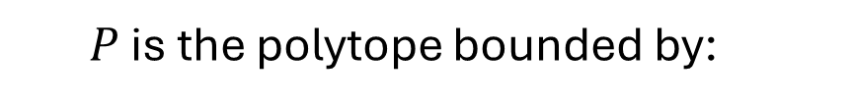

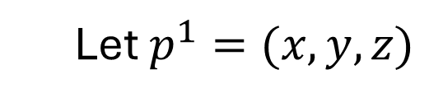


Lemke-Howson Algorithm with $3×3$ payoff matrices
$$P=\left\{p^{1}∈ℝ^{m} \right| {(Π^{2})}^{T}p^{1}≤1, p^{1}≥0\}$$
Player 2 Payoff Matrix
Let $p^{1}=(x,y,z)$
Player 2
$P$ is the polytope bounded by:
A
B
C
$$4x+2y−3z ≤1$$
1
4 | 1 | 3
2 | 3 | 1
-3 | 4 | 2
$$x+3y+4z≤1$$
Player 1
$$3x+y+2z ≤1$$
2
$$x ≥0$$
3
$$y ≥0$$
$$z ≥0$$

Slide 4
Lemke-Howson Algorithm with $3×3$ payoff matrices
$$P=\left\{p^{1}∈ℝ^{m} \right| {(Π^{2})}^{T}p^{1}≤1, p^{1}≥0\}$$
Let $p^{1}=(x,y,z)$
$P$ is the polytope bounded by:
Player 1 Polytope
$$4x+2y−3z ≤1$$
$$x+3y+4z≤1$$
$$3x+y+2z ≤1$$
$$x ≥0$$
$$y ≥0$$
$$z ≥0$$

Slide 5



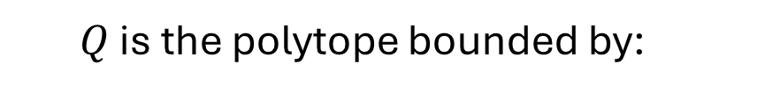

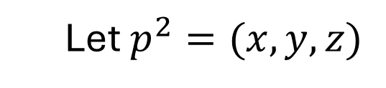


Lemke-Howson Algorithm with $3×3$ payoff matrices
Player 1 Payoff Matrix
$$Q=\left\{p^{2}∈ℝ^{n} \right|Π^{1}p^{2}≤1, p^{2}≥0\}$$
Let $p^{2}=(x,y,z)$
Player 2
$Q$ is the polytope bounded by:
A
B
C
$$4x+y−3z ≤1$$
1
4 | 1 | -3
2 | 4 | -3
1 | 2 | 4
$$2x+4y−3z≤1$$
Player 1
2
$$x+2y+4z ≤1$$
3
$$x ≥0$$
$$y ≥0$$
$$z ≥0$$

Slide 6


Lemke-Howson Algorithm with $3×3$ payoff matrices
$$Q=\left\{p^{2}∈ℝ^{n} \right|Π^{1}p^{2}≤1, p^{2}≥0\}$$
Let $p^{2}=(x,y,z)$
Player 2 Polytope
$Q$ is the polytope bounded by:
$$4x+y−3z ≤1$$
$$2x+4y−3z≤1$$
$$x+2y+4z ≤1$$
$$x ≥0$$
$$y ≥0$$
$$z ≥0$$

Slide 7
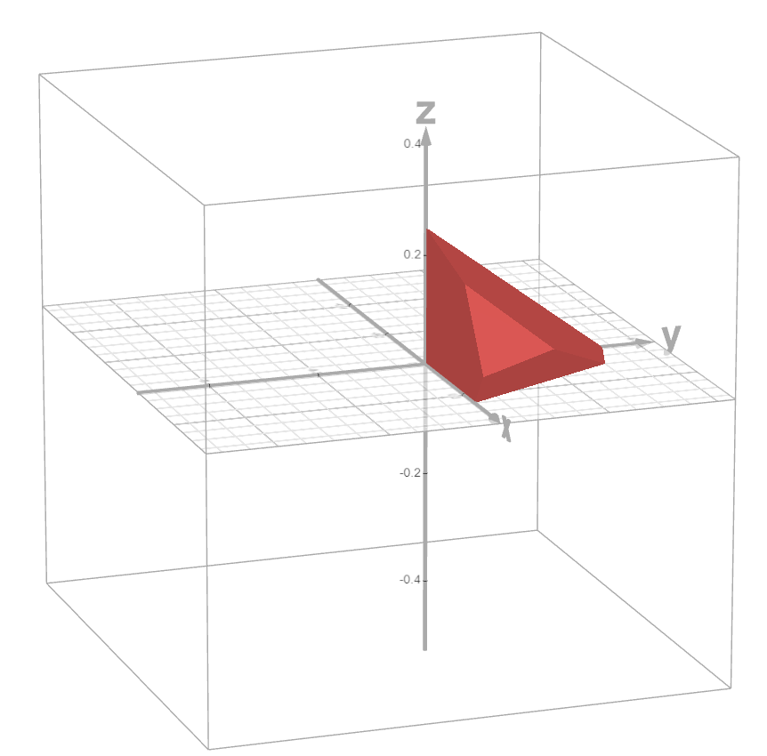
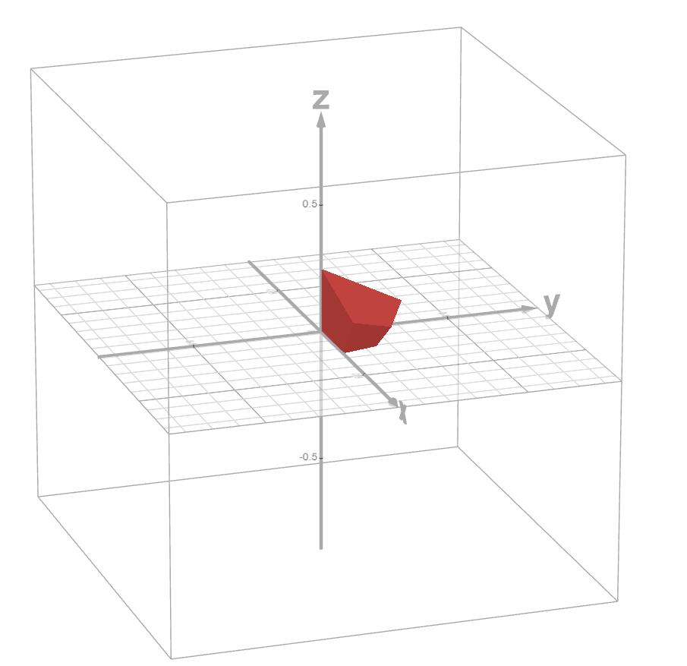
Lemke-Howson Algorithm with $3×3$ payoff matrices
Player 1 Polytope
Player 2 Polytope
Start with the pair of origin vertices
Labels: 1, 2, 3
Labels: A, B, C

Slide 8
Lemke-Howson Algorithm with $3×3$ payoff matrices
Player 1 Polytope
Player 2 Polytope
“Drop” Label 1 from Player 1’s Polytope
Labels: 1, 2, 3
Labels: A, B, C

Slide 9
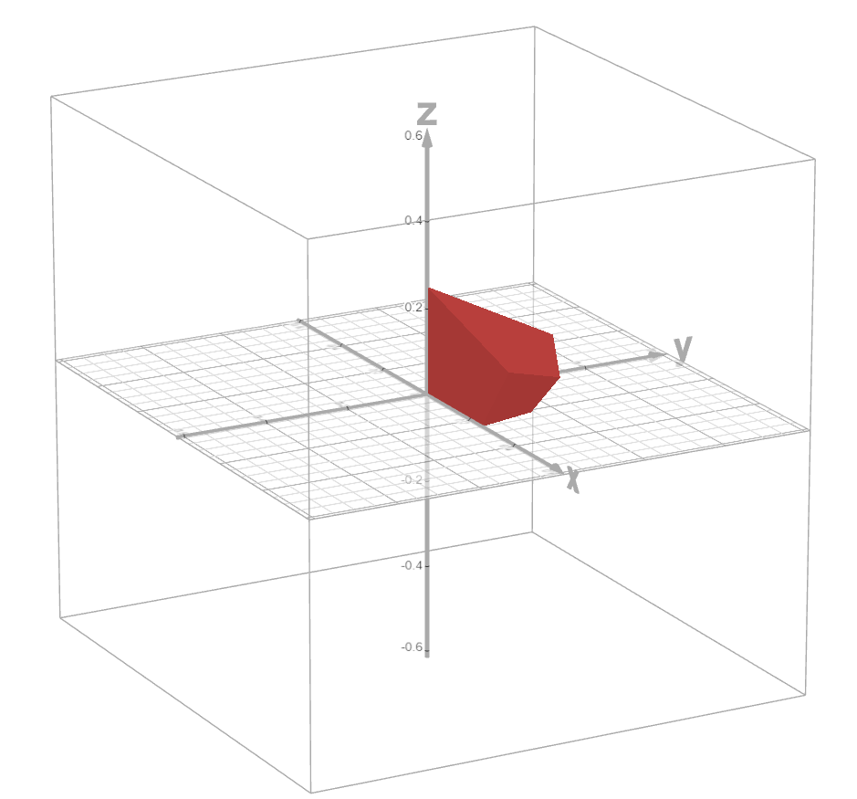
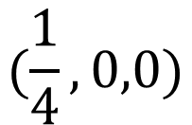

Lemke-Howson Algorithm with $3×3$ payoff matrices
Player 1 Polytope
Player 2 Polytope
“Recover” Label 1 using Player 2’s Polytope
Find adjacent vertex with:
$$4x+y−3z=1$$
$$(\frac{1}{4},0,0)$$
Lose Label A
Labels: 1, 2, 3
Labels: 1, B, C

Slide 10

Lemke-Howson Algorithm with $3×3$ payoff matrices
Player 1 Polytope
Player 2 Polytope
Recover Label A using Player 2’s Polytope
Find adjacent vertex with:
$$4x+2y−3z=1$$
$$(\frac{1}{4},0,0)$$
We Officially Lose Label 1 from Player 1’s
Labels: A, 2, 3
Labels: 1, B, C

Slide 11
Lemke-Howson Algorithm with $3×3$ payoff matrices
Player 1 Polytope
Player 2 Polytope
Wait a minute…
We’re fully labeled!
There is a Nash equilibrium at when Player 1 chooses pure strategy 1 and Player 2 chooses pure strategy A
Labels: A, 2, 3
Labels: 1, B, C

Slide 12
Lemke-Howson Algorithm with $3×3$ payoff matrices
Player 1 Payoff Matrix
Player 2 Payoff Matrix
Player 2
Player 2
A
B
C
A
B
C
1
4 | 1 | -3
2 | 4 | -3
1 | 2 | 4
1
4 | 1 | 3
2 | 3 | 1
-3 | 4 | 2
Player 1
Player 1
2
2
3
3
*No strategies can be eliminated by strict dominance of pure strategies

Slide 13
Lemke-Howson Algorithm with $3×3$ payoff matrices
Player 1 Polytope
Player 2 Polytope
Let’s try this again…
Start with the pair of origin vertices
Labels: 1, 2, 3
Labels: A, B, C

Slide 14
Lemke-Howson Algorithm with $3×3$ payoff matrices
Player 1 Polytope
Player 2 Polytope
“Drop” Label 2 from Player 1’s Polytope
Labels: 1, 2, 3
Labels: A, B, C

Slide 15
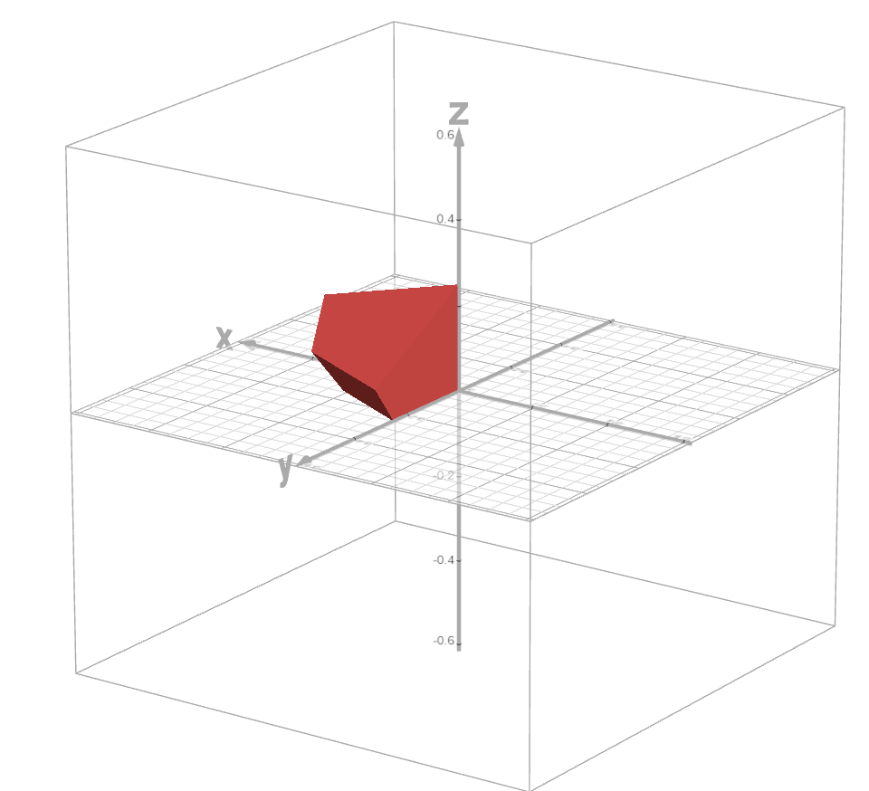
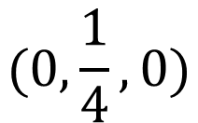

Lemke-Howson Algorithm with $3×3$ payoff matrices
Player 1 Polytope
Player 2 Polytope
“Recover” Label 2 using Player 2’s Polytope
Find adjacent vertex with:
$$2x+4y−3z=1$$
$$(0,\frac{1}{4},0)$$
Lose Label B
Labels: 1, 2, 3
Labels: 2, A, C

Slide 16

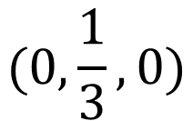

Lemke-Howson Algorithm with $3×3$ payoff matrices
Player 1 Polytope
Player 2 Polytope
“Recover” Label B using Player 1’s Polytope
Find adjacent vertex with:
$$x+3y+4z=1$$
$$(0,\frac{1}{3},0)$$
Lose Label 2
Labels: 1, 3, B
Labels: 2, A, C

Slide 17
Lemke-Howson Algorithm with $3×3$ payoff matrices
Player 1 Polytope
Player 2 Polytope
We are fully labeled again and have thus found another Nash equilibrium
There is another Nash equilibrium at when Player 1 chooses pure strategy 2 and Player 2 chooses pure strategy B
Labels: 1, 3, B
Labels: 2, A, C

Slide 18
Lemke-Howson Algorithm with $3×3$ payoff matrices
Player 1 Payoff Matrix
Player 2 Payoff Matrix
Player 2
Player 2
A
B
C
A
B
C
1
4 | 1 | -3
2 | 4 | -3
1 | 2 | 4
1
4 | 1 | 3
2 | 3 | 1
-3 | 4 | 2
Player 1
Player 1
2
2
3
3
*No strategies can be eliminated by strict dominance of pure strategies

Slide 19
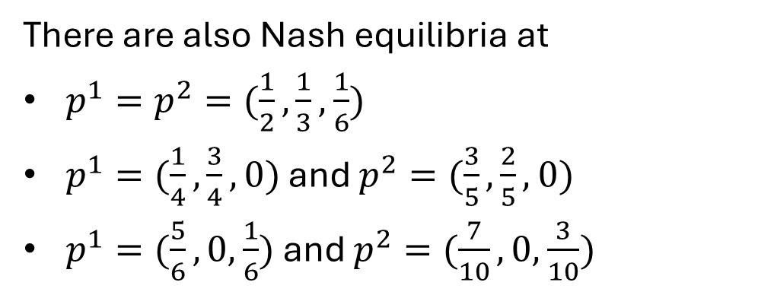
Lemke-Howson Algorithm with $3×3$ payoff matrices
There are also Nash equilibria at
$p^{1}=p^{2}=(\frac{1}{2},\frac{1}{3},$ $\frac{1}{6})$
$p^{1}=(\frac{1}{4},\frac{3}{4},$ $0)$ and $p^{2}=(\frac{3}{5},\frac{2}{5},$ $0)$
$p^{1}=(\frac{5}{6},0,$ $\frac{1}{6})$ and $p^{2}=(\frac{7}{10},0,$ $\frac{3}{10})$
A
B
C
A
B
C
1
4 | 1 | -3
2 | 4 | -3
1 | 2 | 4
1
4 | 1 | 3
2 | 3 | 1
-3 | 4 | 2
2
2
3
3

Slide 20

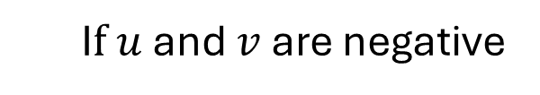
Best Response Polytopes with Negative Expectation
$P=\left\{p^{1}∈ℝ^{m} \right| {(Π^{2})}^{T}p^{1}≤v1, p^{1}$ is a probability vector$\}$
$Q=\left\{p^{2}∈ℝ^{n} \right| Π^{1}p^{2}≤u1, { p}^{2}$ is a probability vector$\}$
I$f u$ and $v$ are positive
I$f u$ and $v$ are negative
$$P=\left\{p^{1}∈ℝ^{m} \right| {(Π^{2})}^{T}p^{1}≤1, p^{1}≥0\}$$
$$Q=\left\{p^{2}∈ℝ^{n} \right| Π^{1}p^{2}≤1, { p}^{2}≥0\}$$
$$P=\left\{p^{1}∈ℝ^{m} \right| {(Π^{2})}^{T}p^{1}≥1, p^{1}≤0\}$$
$$Q=\left\{p^{2}∈ℝ^{n} \right| Π^{1}p^{2}≥1, { p}^{2}≤0\}$$

Slide 21
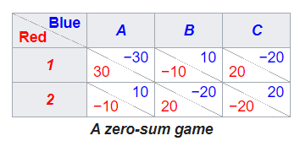
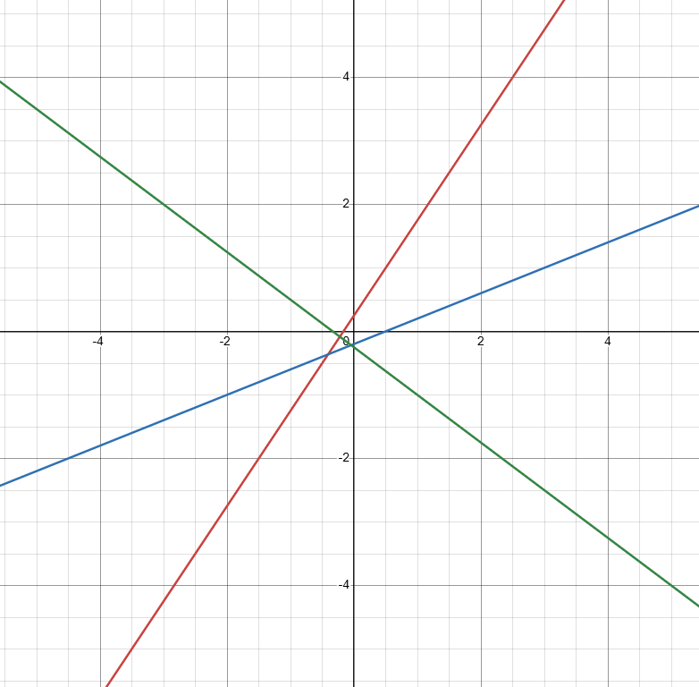
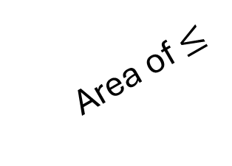



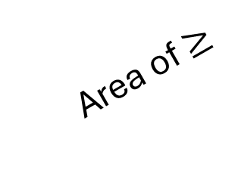
Back to the Example
20
30
-3
-6
-10
2
-20
Area of $≤$
-10
4
20
-5
-4
Expectation value lines bounding our polytope:
Area of $≥$
$$−6x+4y=1$$
$$2x−5y=1$$
The line corresponding to C does not impact the area as C is strictly dominated by a convex hull of A and B
$$−3x−4y=1$$

Slide 22
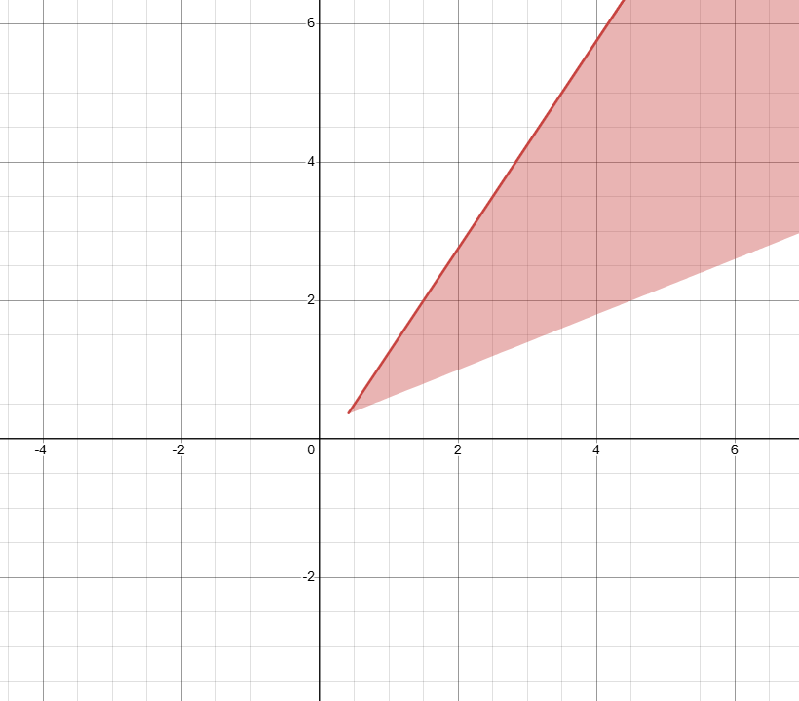
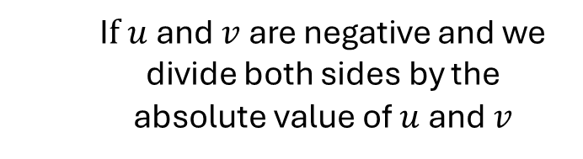



Best Response Polytopes with Negative Expectation
$P=\left\{p^{1}∈ℝ^{m} \right| {(Π^{2})}^{T}p^{1}≤v1, p^{1}$ is a probability vector$\}$
$Q=\left\{p^{2}∈ℝ^{n} \right| Π^{1}p^{2}≤u1, { p}^{2}$ is a probability vector$\}$
I$f u$ and $v$ are negative and we divide both sides by the absolute value of $u$ and $v$
$$P=\left\{p^{1}∈ℝ^{m} \right| {(Π^{2})}^{T}p^{1}≤−1, p^{1}≥0\}$$
$$Q=\left\{p^{2}∈ℝ^{n} \right| Π^{1}p^{2}≤−1, { p}^{2}≥0\}$$
$$−6x+4y≤−1$$
$$−3x−4y≤−1$$
$$2x−5y≤−1$$

Slide 23
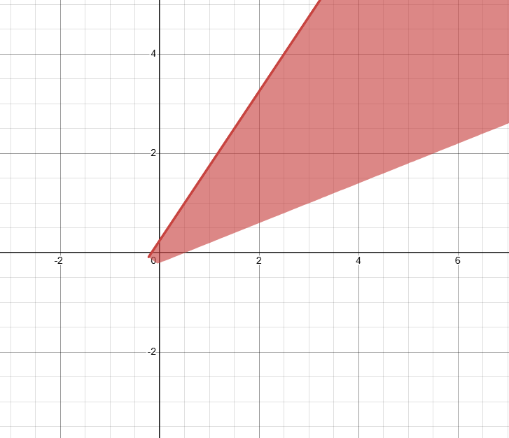






How to Tell When Equilibrium Expectation Value is Negative
$$−6x+4y≤1$$
$$−6x+4y≤−1$$
$$−3x−4y≤1$$
$$−3x−4y≤−1$$
$$2x−5y≤1$$
$$2x−5y≤−1$$

Slide 24
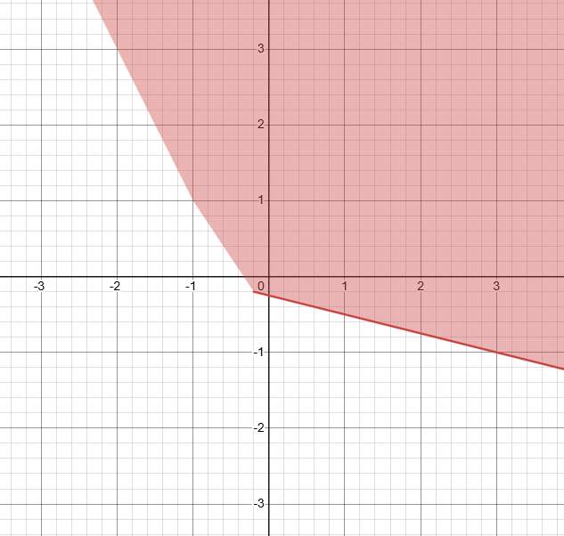



How to Tell When Equilibrium Expectation Value is Negative
-1
-2
-3
-4
-1
-2
$$−x−4y≤1$$
$$−2x−y≤1$$
$$−3x−2y≤1$$

Slide 25
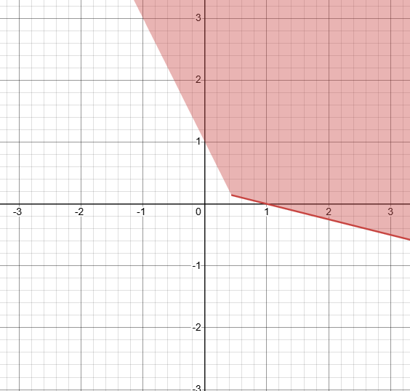



How to Tell When Equilibrium Expectation Value is Negative
-1
-2
-3
-4
-1
-2
Seems to depend on where the vertex with all non-zero entries lies
$$−x−4y≤−1$$
$$−2x−y≤−1$$
$$−3x−2y≤−1$$

Slide 26

Brown - von Neumann- Nash Dynamics
We use the set of continuous functions that Nash defined for his existence proof:
$$φ_{ij}\left(p\right)=max⁡(0, {Payoff}_{i}\left(e_{j}\right)−{Payoff}_{i}\left(p\right))$$
${Payoff}_{i}\left(e_{j}\right) −$ payoff to $i$th Player from playing pure strategy $j$
${Payoff}_{i}\left(p\right) −$ payoff to $i$th Player from playing strategy $p$
$φ_{ij}\left(p\right)−$ either $0$ or the value gained by switching to pure strategy $j$
We evolve each player’s probabilities according to the following ODE:
$${\dot{p}}_{ij}=φ_{ij}\left(p\right)−p_{ij}\sum_{k}{φ_{ik}\left(p\right)}$$
$p_{ij}\left(p\right)−$ the probability that player $i$ chooses strategy $j$

Slide 27
Brown - von Neumann- Nash Dynamics
Consider the two-player game:
Player 1 Payoff Matrix
Player 2 Payoff Matrix
Player 2
Player 2
A
B
A
B
1
7 | 2
3 | 4
1
1 | 6
8 | 2
Player 1
Player 1
2
2
Player 1 Strategy:${ p}^{1}=(x^{1},y^{1})$ Player 2 Strategy:${ p}^{2}=((x^{2},y^{2})$
$$φ_{11}\left(p\right)=max⁡(0, 7x^{2}+2y^{2}−(7x^{1}x^{2}+2x^{1}y^{2}+3y^{1}x^{2}+4y^{1}y^{2}))$$
Value of Strategy 1
Value of current Strategy

Slide 28
Brown - von Neumann- Nash Dynamics
A
B
A
B
1
7 | 2
3 | 4
1
1 | 6
8 | 2
2
2
Player 1 Strategy:${ p}^{1}=(x^{1},y^{1})$ Player 2 Strategy:${ p}^{2}=(x^{2},y^{2})$
$$φ_{11}\left(p\right)=max⁡(0, 7x^{2}+2y^{2}−(7x^{1}x^{2}+2x^{1}y^{2}+3y^{1}x^{2}+4y^{1}y^{2}))$$
$$φ_{12}\left(p\right)=max⁡(0, 3x^{2}+4y^{2}−(7x^{1}x^{2}+2x^{1}y^{2}+3y^{1}x^{2}+4y^{1}y^{2}))$$
$$φ_{2A}\left(p\right)=max⁡(0, x^{1}+8y^{1}−(x^{1}x^{2}+6x^{1}y^{2}+8y^{1}x^{2}+2y^{1}y^{2}))$$
$$φ_{2B}\left(p\right)=max⁡(0, 6x^{1}+2y^{1}−(x^{1}x^{2}+6x^{1}y^{2}+8y^{1}x^{2}+2y^{1}y^{2}))$$

Slide 29



Brown - von Neumann- Nash Dynamics
$${\dot{p}}_{ij}=φ_{ij}\left(p\right)−p_{ij}\sum_{k}{φ_{ik}\left(p\right)}$$
$$\dot{x^{1}}=φ_{11}\left(p\right)−x^{1}(φ_{11}\left(p\right)+φ_{12}\left(p\right))$$
$$\dot{x^{1}}={y^{1}φ}_{11}\left(p\right)−x^{1}φ_{12}\left(p\right)$$
$$\dot{y^{1}}=φ_{12}\left(p\right)−y^{1}(φ_{11}\left(p\right)+φ_{12}\left(p\right))$$
$$\dot{y^{1}}={x^{1}φ}_{12}\left(p\right)−y^{1}φ_{11}\left(p\right)$$
$$\dot{x^{2}}=φ_{2A}\left(p\right)−x^{2}(φ_{2A}\left(p\right)+φ_{2B}\left(p\right))$$
$$\dot{x^{2}}={y^{2}φ}_{2A}\left(p\right)−x^{2}φ_{2B}\left(p\right)$$
$$\dot{y^{2}}=φ_{2B}\left(p\right)−y^{2}(φ_{2A}\left(p\right)+φ_{2B}\left(p\right))$$
$$\dot{y^{2}}={x^{2}φ}_{2B}\left(p\right)−y^{2}φ_{2A}\left(p\right)$$
Note that $p=( \left(x^{1},y^{1}\right), \left(x^{2},y^{2}\right))$ contains the mixed strategy information of all players

Slide 30
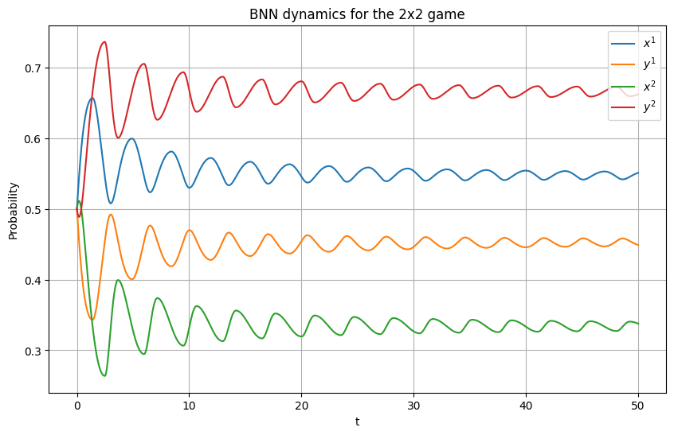
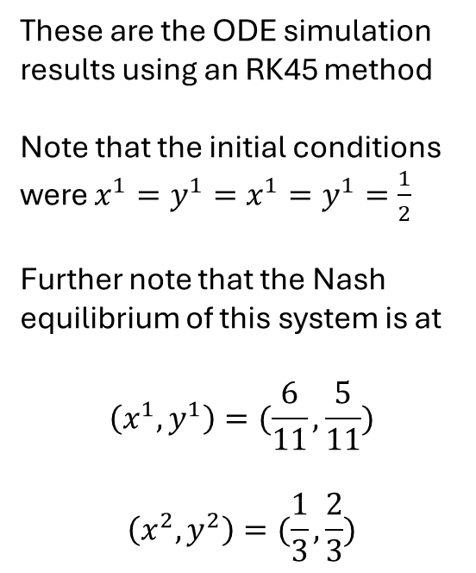
Brown - von Neumann- Nash Dynamics
These are the ODE simulation results using an RK45 method
Note that the initial conditions were $x^{1}=y^{1}=x^{1}=y^{1}=\frac{1}{2}$
Further note that the Nash equilibrium of this system is at
$$\left(x^{1},y^{1}\right)=(\frac{6}{11},\frac{5}{11})$$
$$\left(x^{2},y^{2}\right)=(\frac{1}{3},\frac{2}{3})$$

Slide 31
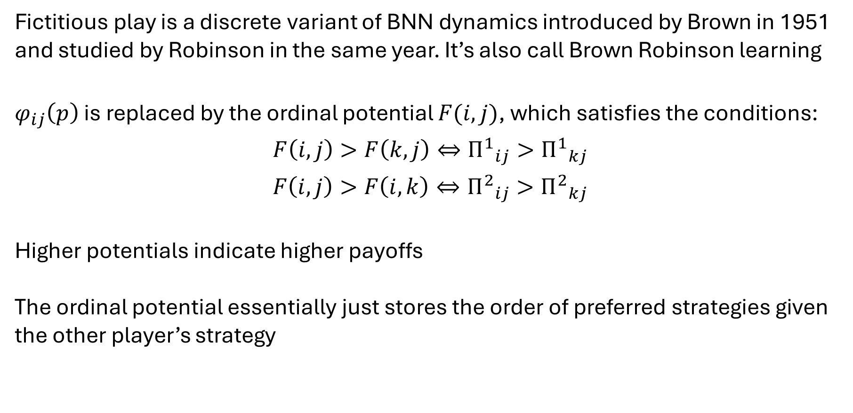
Fictitious Play
Introduction
Fictitious play is a discrete variant of BNN dynamics introduced by Brown in 1951 and studied by Robinson in the same year. It’s also call Brown Robinson learning
$φ_{ij}\left(p\right)$ is replaced by the ordinal potential $F(i,j)$, which satisfies the conditions:
$$F\left(i,j\right)>F\left(k,j\right)⇔{Π^{1}}_{ij}>{Π^{1}}_{kj}$$
$$F\left(i,j\right)>F\left(i,k\right)⇔{Π^{2}}_{ij}>{Π^{2}}_{kj}$$
Higher potentials indicate higher payoffs
The ordinal potential essentially just stores the order of preferred strategies given the other player’s strategy

Slide 32
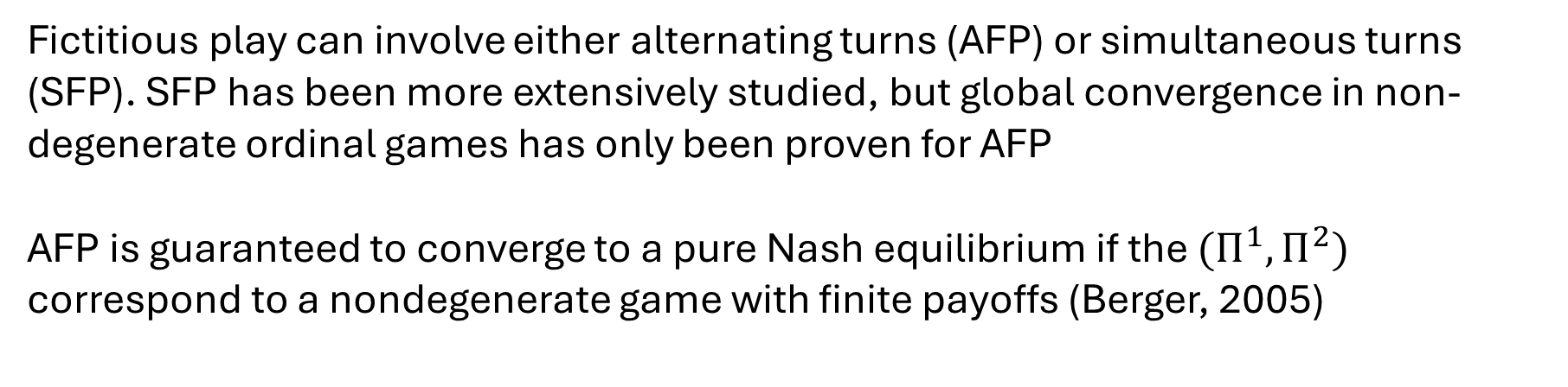
Fictitious Play
Set Up
Fictitious play can involve either alternating turns (AFP) or simultaneous turns (SFP). SFP has been more extensively studied, but global convergence in non-degenerate ordinal games has only been proven for AFP
AFP is guaranteed to converge to a pure Nash equilibrium if the $(Π^{1},Π^{2})$ correspond to a nondegenerate game with finite payoffs (Berger, 2005)

Slide 33
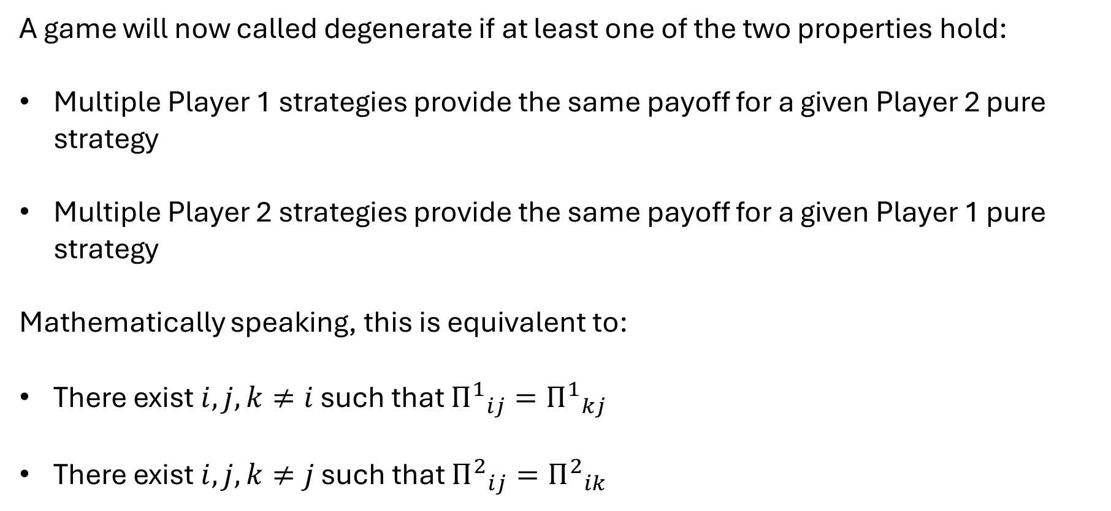
Degenerate Games
A game will now called degenerate if at least one of the two properties hold:
Multiple Player 1 strategies provide the same payoff for a given Player 2 pure strategy
Multiple Player 2 strategies provide the same payoff for a given Player 1 pure strategy
Mathematically speaking, this is equivalent to:
There exist $i,j,k≠i$ such that ${Π^{1}}_{ij}={Π^{1}}_{kj}$
There exist $i,j,k≠j$ such that ${Π^{2}}_{ij}={Π^{2}}_{ik}$

Slide 34
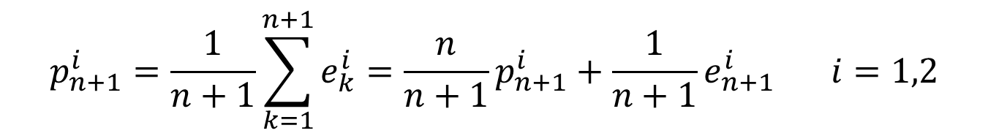
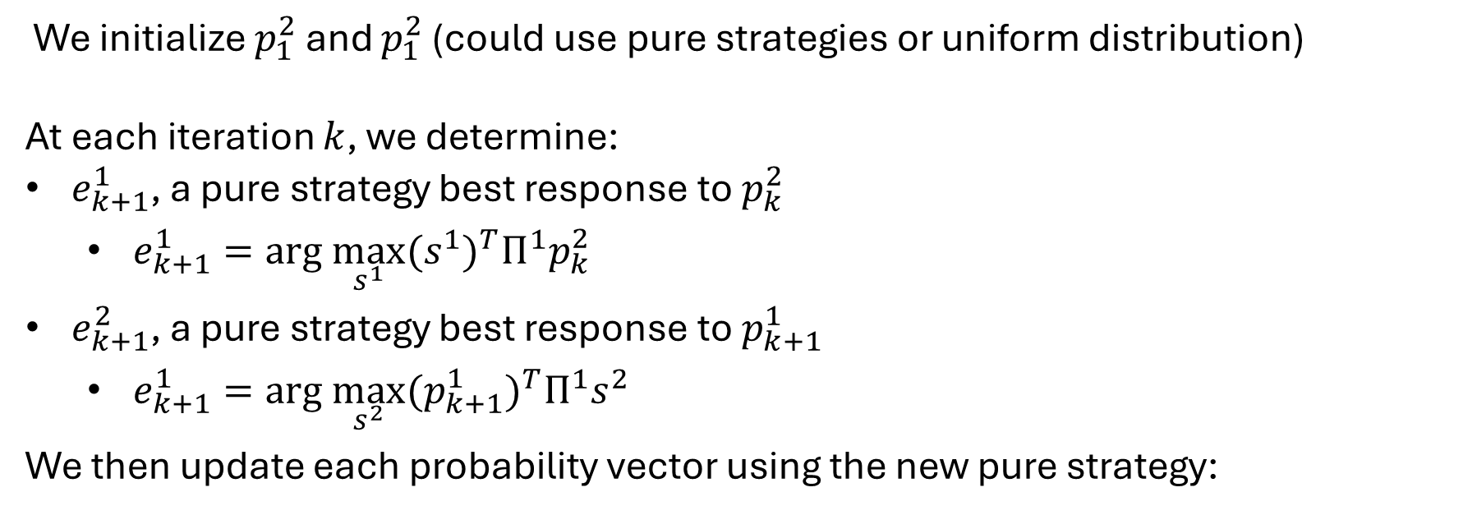
Fictitious Play
AFP Iterations
We initialize $p_{1}^{2}$ and $p_{1}^{2}$ (could use pure strategies or uniform distribution)
At each iteration $k$, we determine:
$e_{k+1}^{1}$, a pure strategy best response to $p_{k}^{2}$
$e_{k+1}^{1}=arg \max_{s^{1}}{{(s^{1})}^{T}Π^{1}p_{k}^{2}}$
$e_{k+1}^{2}$, a pure strategy best response to $p_{k+1}^{1}$
$e_{k+1}^{1}=arg \max_{s^{2}}{{(p_{k+1}^{1})}^{T}Π^{1}s^{2}}$
We then update each probability vector using the new pure strategy:
$$p_{n+1}^{i}=\frac{1}{n+1}\sum_{k=1}^{n+1}{e_{k}^{i}}=\frac{n}{n+1}p_{n+1}^{i}+\frac{1}{n+1}e_{n+1}^{i} i=1,2$$

Slide 35
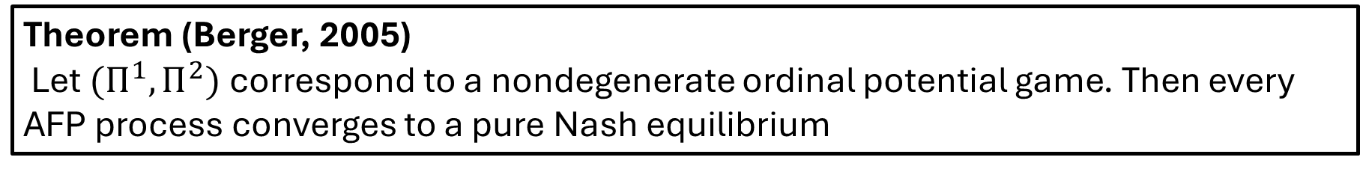
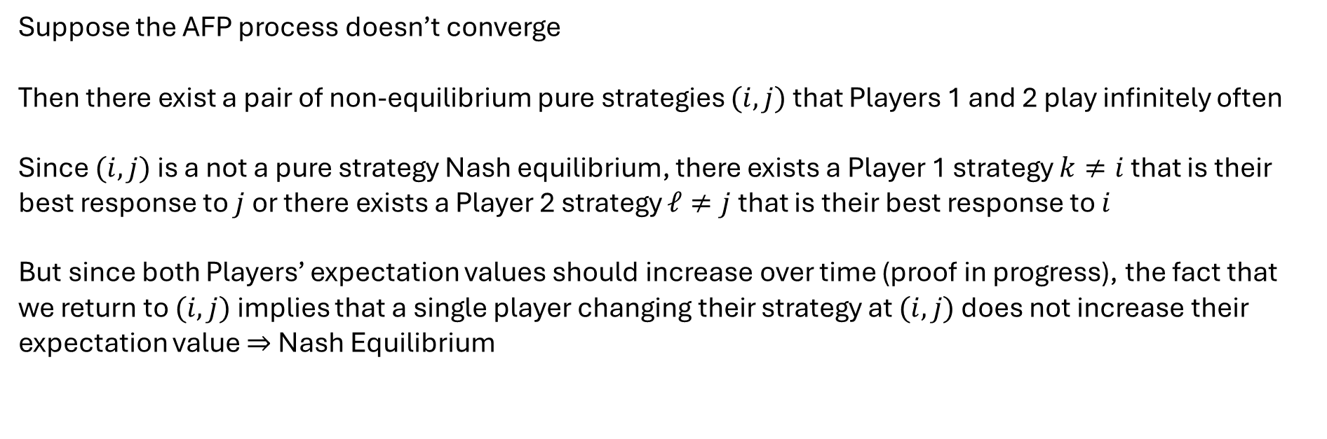
Convergence of Fictitious Play
Theorem (Berger, 2005)
Let$(Π^{1},Π^{2})$ correspond to a nondegenerate ordinal potential game. Then every AFP process converges to a pure Nash equilibrium
Proof by Contradiction
Suppose the AFP process doesn’t converge
Then there exist a pair of non-equilibrium pure strategies $(i,j)$ that Players 1 and 2 play infinitely often
Since $(i,j)$ is a not a pure strategy Nash equilibrium, there exists a Player 1 strategy $k≠i$ that is their best response to $j$ or there exists a Player 2 strategy $ℓ≠j$ that is their best response to $i$
But since both Players’ expectation values should increase over time (proof in progress), the fact that we return to $(i,j)$ implies that a single player changing their strategy at $(i,j)$ does not increase their expectation value $⇒$ Nash Equilibrium

